Slide 1
Hyper-Path-Based Representation Learning for Hyper-Networks
Jie Huang¹, Xin Liu², Yangqiu Song²
¹School of Data and Computer Science, Sun Yat-sen University
²Department of CSE, The Hong Kong University of Science and Technology

Slide 2
Many Real Applications can be Represented as Hyper-Networks
Rash
Lipitor
Drug hypersensitivity
Chantix
Muscular weakness
Bob
Alice
Death
(user, drug, reaction) hyper-network
Notes:
Many real applications can be represented as hyper-networks.
For example, the (user, drug, reaction) hyper-network corresponds to complex connections that users produce some reactions after taking drugs.
Alice takes Lipitor and then she has rash and drug hypersensitivity.
But Bob has a different reaction after taking the same drug, the muscular weakness.
What's worse, he is dead after taking Chantix.
Hence, reactions vary from both users and drugs.

Slide 3
Many Real Applications can be Represented as Hyper-Networks
Alice
Sci-fi
philosophy
Bob
The Matrix
(1999)
Inception
(2010)
(user, movie, tag) hyper-network
Notes:
Usually, we represent users, movies and tags as conventional networks, where relations are binary.
We can also model connections as tuples in a (user, movie, tag) hyper-networks.
Alice tags The Matrix as philosophy, while Bob tags this movie as science fiction.
Different tags show their individual interests and different angles when enjoying this movie.
Bob also tags the Inception as science fiction.
Hence, a good recommender system should recommend Bob some science fiction movies but provide Alice some choices about philosophy.

Slide 4
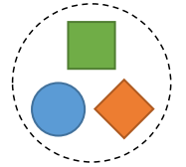
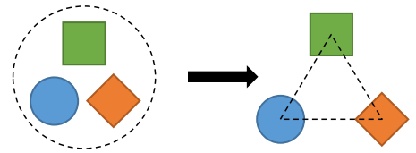
Hyperedge in Hyper-Networks
Hyperedge: connecting more than two nodes
Indecomposability: a strong relationship cannot be decomposed to binary relations (Tu et al., AAAI’2018)
?
Ke Tu, Peng Cui, Xiao Wang, Fei Wang, and Wenwu Zhu. 2018. Structural deep embedding for hyper-networks. In AAAI. 426–433.
Notes:
Generally, we can use different shapes to represent nodes with different node types and a circle to represent a hyperedge.
The biggest difference between conventional networks and hyper-networks is the edge.
In hyper-networks, an edge usually connects more than two nodes and we name it as a hyperedge.
Tu proposed the indecomposability of hyper-networks and hyperedges. That is, a storng relationship cannot be decomposed to binary relations.
But is the indecomposability universal to all hyper-networks?

Slide 5
Degree of Indecomposability
(user, drug, reaction) hyper-network:
reaction
×
reaction
user
drug
user
drug
(user, movie, tag) hyper-network:
tag
√
tag
user
movie
user
movie
Different hyper-networks may have different degrees of indecomposability
Notes:
Look at the two examples again, the (user,drug,reaction) relations are hard to decompose because reactions vary from both users and drugs.
(user,drug) pairs and (user,reaction) pairs cannot be independent, but drugs and reactions do have some relationships because some drugs usually have common side effects.
However, the (user,movie,tag) relations may be decomposed to binary relations. Tags mostly depend on contents of movies; tags can also show language habits of users. And users often have preferences of specific movies.
Above all, we hold the view that different hyper-networks may have different degrees of indecomposability.

Slide 6
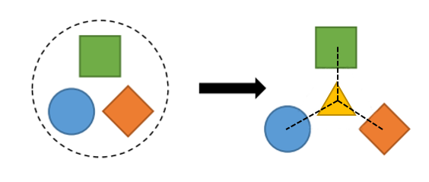
Existing Methods
Converting hyper-networks to conventional pairwise networks and applying network embedding methods
Star expansion (Agarwal et al., ICML'2006)
Clique expansion (Sun et al., KDD'2008)
Recent representation learning methods (including deep learning)
DHNE (Tu et al. , AAAI'2018)
HHNE (Baytas et al. ICDM'2018)
HGE (Yu et al. CIKM'2018)
Problem: less consideration of the degrees of indecomposability
Sameer Agarwal, Kristin Branson, and Serge Belongie. 2006. Higher order learning with graphs. In ICML. ACM, 17–24
Liang Sun, Shuiwang Ji, and Jieping Ye. 2008. Hypergraph spectral learning for multi-label classification. In SIGKDD. ACM, 668–676.
Ke Tu, Peng Cui, Xiao Wang, Fei Wang, and Wenwu Zhu. 2018. Structural deep embedding for hyper-networks. In AAAI. 426–433.
Inci M Baytas, Cao Xiao, Fei Wang, Anil K Jain, and Jiayu Zhou. 2018. Heterogeneous Hyper-Network Embedding. In ICDM. IEEE, 875–880. Chia-An Yu, Ching-Lun Tai, Tak-Shing Chan, and Yi-Hsuan Yang. 2018. Modeling Multi-way Relations with Hypergraph Embedding. In CIKM. ACM, 1707–1710.
Notes:
Some researchers have tried to model hyper-networks in different ways.
One traditional way is to convert hyper-networks to conventional pairwise networks and then apply network embedding methods. There are star expansion and clique expansion.
Recently, some methods for hyper-networks are proposed, including deep learning methods.
But all these methods rarely consider the degrees of indecomposability. Traditional methods assume hyper-networks are decomposable while new methods suppose hyper-networks are indecomposable.

Slide 7
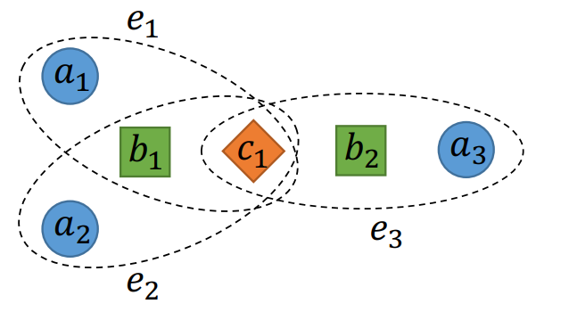
Indecomposable Factor
Coupled edge pair: if one specific node is removed, all other nodes in a hyperedge can be covered by another hyperedge
$(e_{1},e_{2})$ is a coupled edge pair (removing $a_{1},a_{2}$)
$(e_{1},e_{3})$ is not a coupled edge pair
$(e_{2},e_{3})$ is not a coupled edge pair
Indecomposable Factor
$ξ_{t}=\frac{β+\frac{1}{|ℰ_{random}|}\sum_{e∈ℰ_{random}}{δ_{1}(ℰ, e,t)}}{β+\frac{1}{|ℰ|}\sum_{e∈ℰ}{δ_{1}(ℰ,e,t)}}$,
where $0<β≪1$ is a smoothing hyperparameter, $ℰ_{random}$ is a hyperedge set generated randomly from $𝒱$ of $𝒢$, $δ_{1}(ℰ, e,t)$ is an indicator function whether there is another hyperedge $e^{′}∈ℰ$ such that $(e,e^{′})$ is a coupled edge pair and the removed node type is $t$.
$δ_{1}\left(ℰ, e_{1},a\right)=δ_{1}\left(ℰ, e_{2},a\right)=1$
$δ_{1}\left(ℰ, e_{1},b\right)=δ_{1}\left(ℰ, e_{2},b\right)=0$
$δ_{1}\left(ℰ, e_{1},c\right)=δ_{1}\left(ℰ, e_{2},c\right)=0$
Notes:
To model the degree of indecomposability, we firstly define the coupled edge pair.
Two hyperedges are coupled if one specific node is removed, all other nodes in a hyperedge can be covered by the other hyperedge.
In the right hyper-network, (e1,e2) is a coupled edge pair because we can remove a1 or a2. But (e1,e3) and (e2,e3) are not because either of them only shares c1.
Then we can define the indecomposable factor, KSAI T for each node type T.
Here BETA is a smoothing hyperparameter, E random is the hyperedge set generated randomly from V, DELTA1 is an indicator function whether there is another hyperedge e' in the E such that (e,e') is a coupled edge pair and the removed node type is t.
In the right hyper-network, only DELTA1(E,e1,a) and DELTA1(E,e2, a) are equal to 1 and others are 0.
I will give two more examples to show how this factor can model the degree of indecomposability.

Slide 8
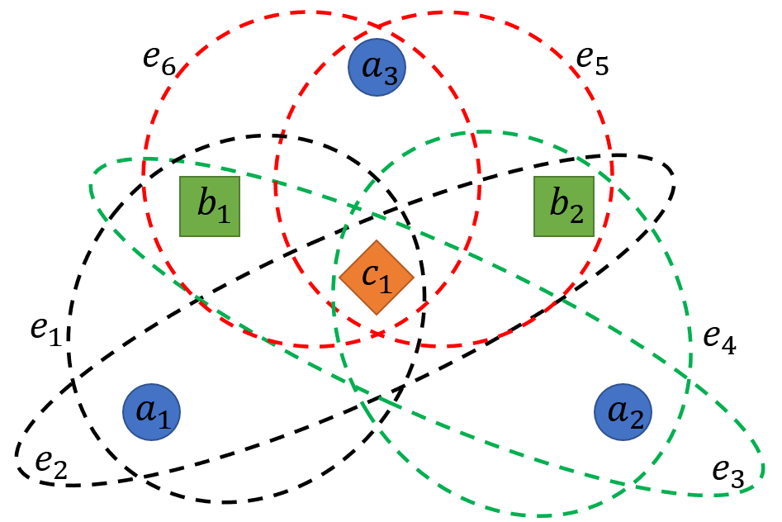
Indecomposable Factor
Indecomposable Factor
$$ξ_{t}=\frac{β+\frac{1}{|ℰ_{random}|}\sum_{e∈ℰ_{random}}{δ_{1}(ℰ, e,t)}}{β+\frac{1}{|ℰ|}\sum_{e∈ℰ}{δ_{1}(ℰ,e,t)}}$$
Random graph:
$$\frac{1}{|ℰ_{random}|}\sum_{e∈ℰ_{random}}{δ_{1}(ℰ,e,a)}=\frac{1}{6}\left(1+1+1+1+0+1\right)=\frac{5}{6}$$
$$\frac{1}{|ℰ_{random}|}\sum_{e∈ℰ_{random}}{δ_{1}(ℰ,e,b)}=\frac{1}{6}\left(0+1+1+0+1+0\right)=\frac{1}{2}$$
$$\frac{1}{|ℰ_{random}|}\sum_{e∈ℰ_{random}}{δ_{1}(ℰ,e,c)}=\frac{1}{6}\left(0+0+0+0+0\right)=0$$
Target graph:
$$\frac{1}{|ℰ|}\sum_{e∈ℰ}{δ_{1}(ℰ,e,a)}=\frac{1}{3}\left(1+1+0\right)=\frac{2}{3}$$
$$\frac{1}{|ℰ|}\sum_{e∈ℰ}{δ_{1}(ℰ,e,b)}=\frac{1}{3}\left(0+0+0\right)=0$$
$$\frac{1}{|ℰ|}\sum_{e∈ℰ}{δ_{1}(ℰ,e,c)}=\frac{1}{3}\left(0+0+0\right)=0$$
$ξ_{a}=\frac{β+\frac{5}{6}}{β+\frac{2}{3}}≈\frac{5}{4}$, $ξ_{b}=\frac{β+\frac{1}{2}}{β+0}=1+\frac{1}{2β}≫1$, $ξ_{c}=\frac{β+0}{β+0}=1$
Notes:
The left part is a target graph that we want to compute indecomposable factors, and the right part is a random graph.
In the target graph, we can get DELTA1(E,e1,a), DELTA1(E,e1,b), DELTA1(E,e1,c) and the results are 1,0,0.
Similarly, we can get results of DELTA1(E,e2,a), DELTA1(E,e2,b), DELTA1(E,e2,c), which are 1,0,0, and results of DELTA1(E,e3,a), DELTA1(E,e3,b), DELTA1(E,e3,c), which are 0,0,0.
We can also compute necessary values from the random graph. The first parameter of DELTA1 is the edge set of the target graph and the second parameter is the hyperedge of the random graph.
Finally, we can get KSAI A, KSAI B, and KSAI C.

Slide 9
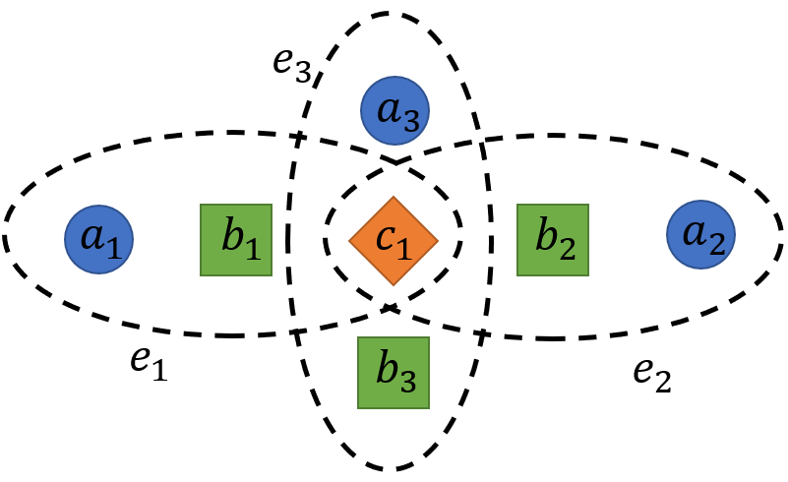
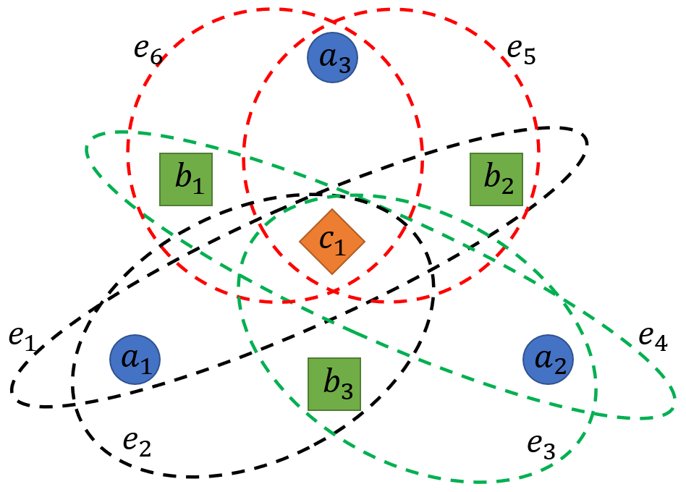
Indecomposable Factor
Indecomposable Factor
$$ξ_{t}=\frac{β+\frac{1}{|ℰ_{random}|}\sum_{e∈ℰ_{random}}{δ_{1}(ℰ, e,t)}}{β+\frac{1}{|ℰ|}\sum_{e∈ℰ}{δ_{1}(ℰ,e,t)}}$$
Random graph:
$$\frac{1}{|ℰ_{random}|}\sum_{e∈ℰ_{random}}{δ_{1}(ℰ,e,a)}=\frac{1}{6}\left(1+1+1+1+1+1\right)=1$$
$$\frac{1}{|ℰ_{random}|}\sum_{e∈ℰ_{random}}{δ_{1}(ℰ,e,b)}=\frac{1}{6}\left(1+1+1+1+1+1\right)=1$$
$$\frac{1}{|ℰ_{random}|}\sum_{e∈ℰ_{random}}{δ_{1}(ℰ,e,c)}=\frac{1}{6}\left(0+0+0+0+0\right)=0$$
Target graph:
$$\frac{1}{|ℰ|}\sum_{e∈ℰ}{δ_{1}(ℰ,e,a)}=\frac{1}{3}\left(0+0+0\right)=0$$
$$\frac{1}{|ℰ|}\sum_{e∈ℰ}{δ_{1}(ℰ,e,b)}=\frac{1}{3}\left(0+0+0\right)=0$$
$$\frac{1}{|ℰ|}\sum_{e∈ℰ}{δ_{1}(ℰ,e,c)}=\frac{1}{3}\left(0+0+0\right)=0$$
$ξ_{a}=\frac{β+1}{β+0}=1+\frac{1}{β}≫1$, $ξ_{b}=\frac{β+1}{β+0}=1+\frac{1}{β}≫1$, $ξ_{c}=\frac{β+0}{β+0}=1$
Notes:
Here is a different example. We can also get KSAI A, KSAI B, and KSAI C for the new target graph.

Slide 10
Indecomposable Factor
Graph1:
$ξ_{a}=\frac{β+\frac{5}{6}}{β+\frac{2}{3}}≈\frac{5}{4}$,
$ξ_{b}=\frac{β+\frac{1}{2}}{β+0}=1+\frac{1}{2β}≫1$,
$$ξ_{c}=\frac{β+0}{β+0}=1$$
Graph2:
$ξ_{a}=\frac{β+1}{β+0}=1+\frac{1}{β}≫1$,
$ξ_{b}=\frac{β+1}{β+0}=1+\frac{1}{β}≫1$,
$$ξ_{c}=\frac{β+0}{β+0}=1$$
If $ξ_{t}≫1$, then nodes with type $t$ are highly associated with other nodes so that hyperedges containing these nodes cannot be decomposed
If $ξ_{t}≈1$, then this hyper-network is a kind of random hyper-network
If $ξ_{t}≪1$, then nodes with type $t$ may be decomposed
Notes:
We put the two graphs together and see what the difference is.
Graph2 has three nodes with type B. And type A nodes and type A nodes are highly associated.
Hence, the KSAI A of graph 2 is much larger than KSAI A of graph 1, which shows hyperedges in graph 2, especially those containing type A nodes, have a higher degree of indecomposability thanks to the higher association between type A nodes and type B nodes.
And generally, if KSAI T is much larger than 1, then nodes with type T are highly associated with the other nodes so that hyperedges containing these nodes cannot be decomposed.
If KSAI T is roughly equal to 1, then this hyper-network is a kind of random hyper-network.
But if KSAI T is less than 1, we may need to consider hyperedges with type T nodes to be able to decompose.

Slide 11
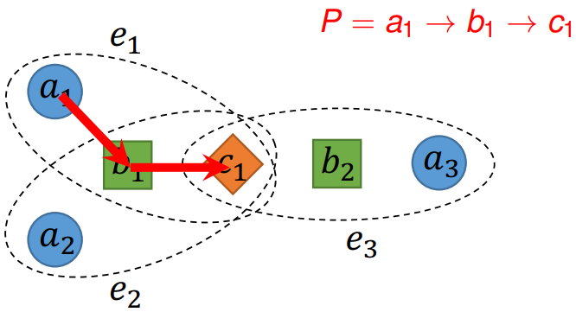
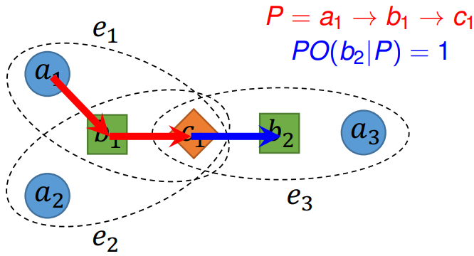
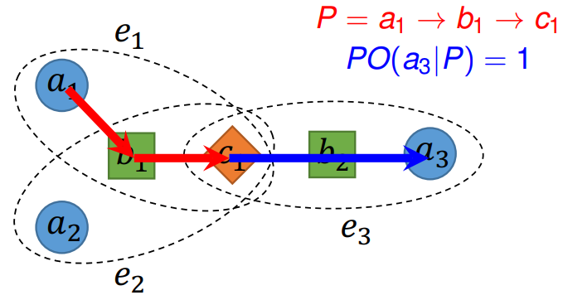
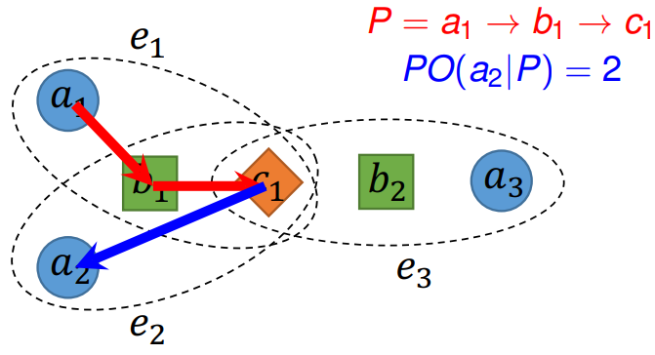
Path Order
Path order:
$$PO\left(v | P\right)=\max{k}$$
$$s.t. 1.∃e∈ℰ \left(P\left[−k\right], …, P\left[−1\right]∈e\right)∧\left(v∈e\right)$$
$2. P\left[−k\right]≠…≠P\left[−1\right]≠v$,
It depends on how many hyperedges containing the node $v$ and the last $k$ nodes of the path at the same time
Notes:
The indecomposable factor describes the degree of indecomposability of nodes with a specific type. Furthermore, we define the path order to model different behaviors of different nodes.
The path order only depends on the current path and hyperedges containing this node.
Assume current path is a1->b1->c1, now we want to select a new node from candidate nodes.
b2 is in the hyperedge e3 and e3 shares c1 with this path. So the path order of b2 is 1.
Similarly, the path order of a3 is 1, as well.
But e2 shares b1 and c1 with this path, so the path order of a2 is 2.

Slide 12
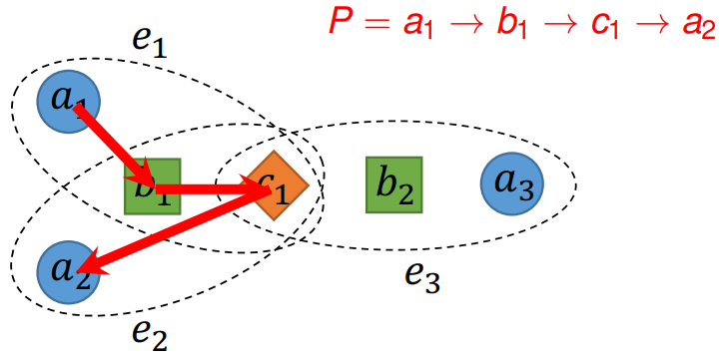
Hyper-Path-Based Random Walk
Hyper-path: a path which is generated based on the rule: starting from node $v_{s}$, selecting the node from the nodes with the largest path order as the next node of the current path
select $a_{2}$
Hyper-path-based random walk:
$π_{2}\left(v | P\right)=π_{1}(v|\left[P\left[−1\right]\right)⋅exp\left(α⋅ξ_{φ\left(v\right)}⋅\left(PO\left(v|P\right)−1\right)\right)$,
where $π_{1}\left(v | P\left[−1\right]\right)=\left\{\begin{aligned}1, v∈𝒩_{𝒢}(P[−1]) \\ 0, otherwise \end{aligned}\right.$ is the first order transition probability, $α$ is a coefficient to control the tendency toward hyper-path
Notes:
We define a new kind of path, named as the hyper-path, which always selects the node with the largest path order as the next node.
And we can also define a new kind of random walk, which controls by nodes' neighbors, the indecomposable factors and path orders.
This kind of random walk is also biased but it considers not only the topologic information but the global statistic factors and coupling information between the path and hyperedges.

Slide 13
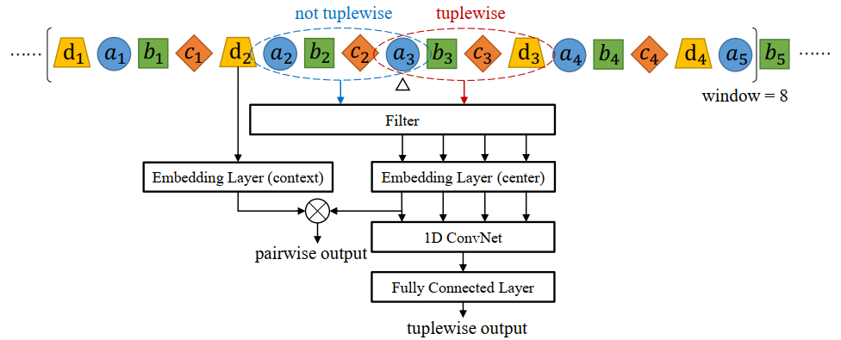
Hyper-Gram
Basic idea:
Pairwise relationships: two nodes close to each other in random walks
Tuplewise relationships: several consecutive nodes in hyper-path-based random walks
The two types of relations should be jointly trained together
Notes:
As we claimed before, hyper-networks have different degrees of indecomposability. Hence, we propose a model to combine pairwise relationships and tuplewise relationships and train jointly.

Slide 14
Hyper-Gram
Similarities
Pairwise similarity: $s_{pair}\left(v_{1},v_{2}\right)=\prod_{w∈𝒱}{p\left(w | v_{1}\right)p(w|v_{2})}$
Tuplewise similarity: $s_{tuple}\left(y\right)=δ_{2}\left(y\right)⋅σ(Wc+b)$, where $y=(y_{1},…y_{k})$ is a tuple, $δ_{2}\left(y\right)$ is an indicator function to check whether $y$ satisfies the type requirement of a hyperedge, $σ(⋅)$ is the sigmoid function, $c$ is the distributed representation of $y$, $W$ and $b$ are trainable parameters
Notes:
We follow Skip-gram to define the pairwise similarity, which is the sum of product of probabilities to predict same window words.
As for the tuplewise similarity, we use a simple a convolutional neural network and a fully connected layer. Here, y is a tuple, and DELTA2 is an indicator function to check whether y satisfies the type requirement of a hyperedge, SIGMA is the sigmoid function, c is the output of CNN. W and b are trainable vectors.

Slide 15
Hyper-Gram
Objective:
where $λ$ is a hyperparameter to balance the pairwise loss and tuplewise loss, negative sampling is used for learning pairwise similarities and tuplewise similarities.
Notes:
After defining the similarities, the objective function is obvious to maximize the pairwise similarities and tuplewise similarities together. Where lambda is a hyperparameter to balance the two losses. We also use negative sampling to speed up.

Slide 16
Baselines and Algorithms
Our models
HPSG: Hyper-path-based random walks + Skip-gram
HPHG: Hyper-path-based random walks + Hyper-gram
Baselines
4 conventional network representation learning methods
DeepWalk (Perozzi et al., KDD'2014)
Node2Vec (Grover et al., KDD'2016)
Metapath2vec (Dong et al., KDD'2017)
LINE (Tang et al., WWW'2015)
3 hyper-network representation learning methods
HHE (Zhu et al., Neurocomputing'2016)
HGE (Yu et al., CIKM'2018)
DHNE (Tu et al., AAAI'2018)
Notes:
To evaluate our ideas, we define two models. The first one is HPSG, which combines the hyper-path-based random walks with Skip-gram, and the other model is HPHG, which combines the hyper-path-based random walks with Hyper-gram.
7 baselines are compared with our models, including 4 conventional network embedding methods and 3 hyper-network embedding methods. Here DHNE is a deep neural model and designed for the link prediction task.

Slide 17
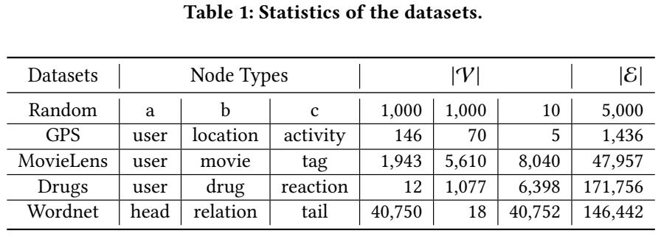
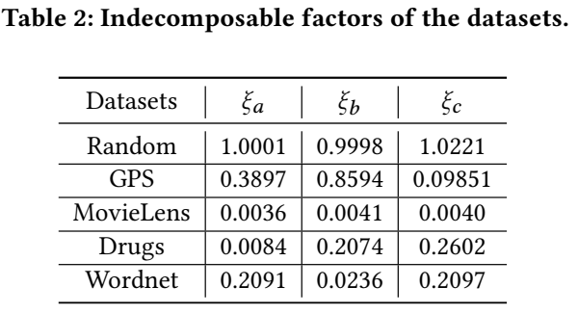
Datasets
Datasets
Indecomposable factors
Notes:
1 random hyper-network is to check the indecomposable factors. Without any prior knowledge, the indecomposable factors are roughly equal to 1.
Indecomposable factors of 4 real life datasets show that hyper-networks have different degrees of indecomposability. And GPS has the largest factors while MovieLens has the lowest ones.

Slide 18
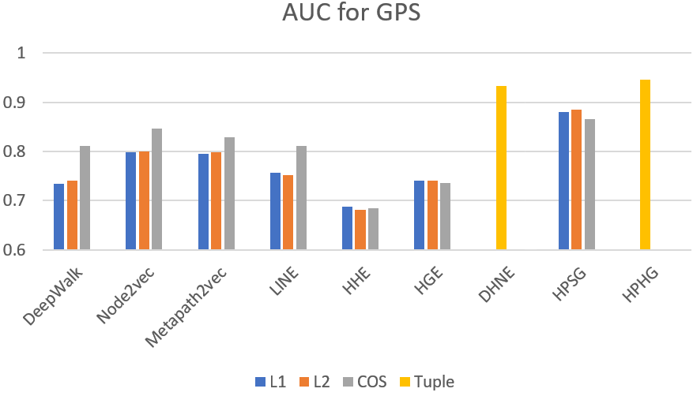
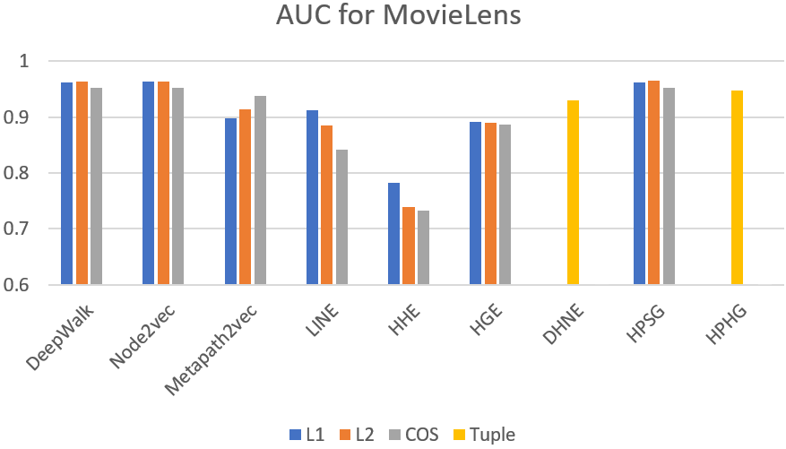
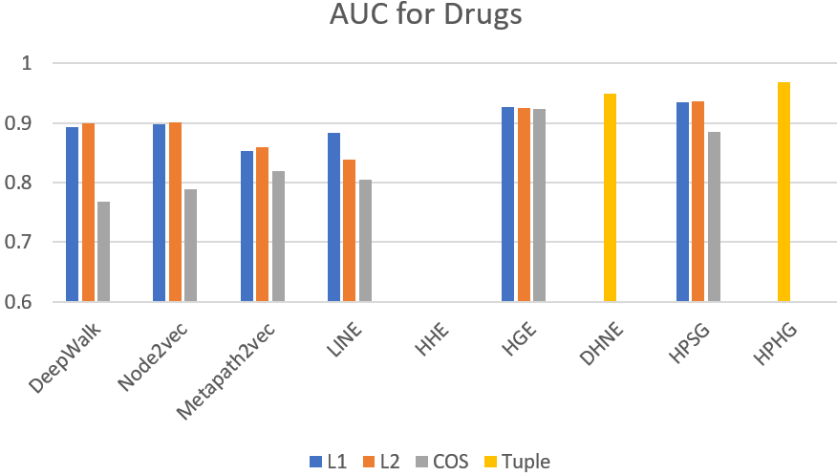
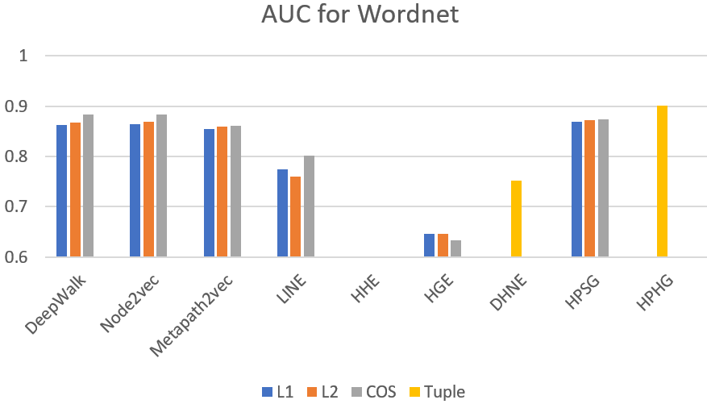
Link Prediction Results
Results
For GPS, Drugs and Wordnet, HPHG outperforms other baselines
For MovieLens, HPSG outperforms other baselines, and traditional methods also perform well
Notes:
As shown in figures, for GPS, Drugs, and Wordnet, HPHG outperforms other baselines.
As I mentioned before, MovieLens has the lowest indecomposable factors. HPSG outperforms other baselines, and traditional methods also perform well. So it is necessary for us to take degrees of indecomposability into consideration.

Slide 19
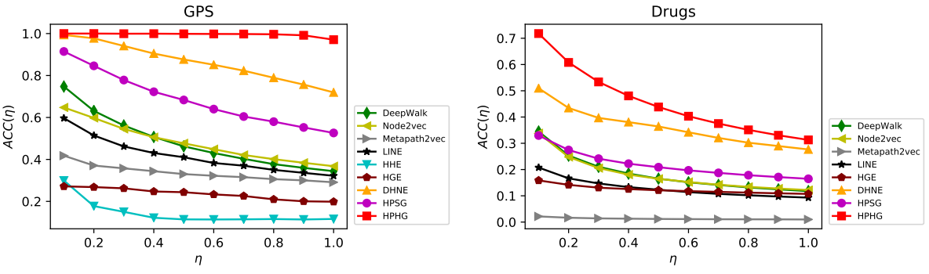
Hyper-Network Reconstruction Results
Evaluation metric: $ACC\left(η\right)=\frac{1}{η\left|ℰ\right|}\sum_{i=1}^{η\left|ℰ\right|}{r_{i}}(0<η<1)$, where $r_{i}=1$ when i-th candidate hyperedge exists in the original hyper-network and $r_{i}=0$ otherwise, , $η$ is a fraction to control the percentage of hyperedges reconstruct.
Results
HPHG outperforms all baselines significantly, and achieves 97.08% accuracy when reconstructing the entire GPS hyper-network
HPSG can also beat traditional baselines
The performance boost from HPSG to HPHG is also significant
Notes:
We also evaluate models and baselines on the hyper-network reconstruction task. The evaluation metric is the accuracy, how many most confident candidate tuples truly exist in the original hyper-network.
As shown in the two figures, HPHG still outperforms all baselines significantly, and achieves 97.08% accuracy when reconstructing the entire GPS hyper-network.
What's more, HPSG can also beat traditional baselines.
When we look at HPHG and HPSG, we can still find the performance boost is also significant. Both pairwise relationships and tuplewise relationships are important in hypernetworks.

Slide 20
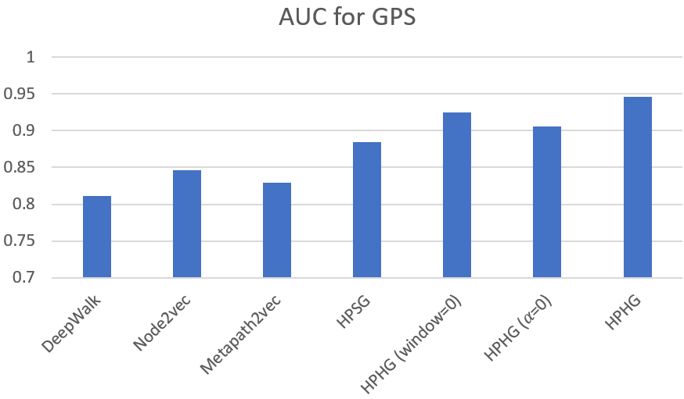
Ablation Study for the Link Prediction Task
Two models
HPSG: Hyper-path-based random walks + Skip-gram, focuses on pairwise relations
HPHG: Hyper-path-based random walks + Hyper-gram, focuses on both relations
Variant models
HPHG (window=0): hyper-path-based random walks + CNN, focuses on tuplewise relations
HPHG ($α$=0): random walks + Hyper-gram, misses the hyper-path-based random walks
Results
The hyper-path-based random walks are better than first order and second order random walks
Hyper-gram is better than Skip-gram
HPHG owns advantages above and achieves the best result
Tuplewise relations are more important than pairwise relations on GPS
Notes:
We also implement 2 variants. One focuses on tuplewise relationships, and the other uses simple random walks.
When we see the performance of DeepWalk, Node2vec and HPSG, we can find hyper-path-based random walks are better than first order and second order random walks.
When we see DeepWalk and HPHG with alpha equal to 0, it is obvious that Hyper-gram is better than Skip-gram.
Of course, HPHG is the best thanks to the advantages above.
When we compare HPHG with window size as 0 and HPSG, we can conclude that tuplewise relations are more important than pairwise relationship on GPS.

Slide 21
Conclusions
Indecomposable factor: depict degrees of indecomposability for hyper-networks
Hyper-path: guide a random walker to generate paths with more structure information
Hyper-gram: capture both pairwise relationships and tuplewise relationships
New state-of-the-art models on link prediction for hyper-networks and hyper-network reconstruction
Paper:
Code:
Thanks
Emails: huangj285@mail2.sysu.edu.cn
xliucr@cse.ust.hk
Notes:
To summary, we have defined the indecomposable factors to depict degrees of indecomposability for hyper-networks.
And we utilize the hyper-path to guide the random walker to generate paths with more structure information.
What's more, Hyper-gram can capture both pairwise relationships and tuplewise relationships.
Finally, we propose new state-of-the-art models on link prediction for hyper-networks and hyper-network reconstruction.
Thanks for your listening.
If you are interested in our work, please read our paper and check our code. And welcome any questions.

